Slide 1

Sales Lead and Quote Management Solution

Slide 2


How Sales Leads Drive Mindshare
A Good Lead System Will:
    Drive Continuous Sales Team Activity
    Drive Confidence in Selling Your Line
    Open New Doors of Opportunity
    Drive New Sales Success
Give them a steady stream of “high quality” leads and they will focus on your line!
@2025 Interlynx Systems, LLC. All right reserved. No part of this presentation may be reproduced, distributed, or transmitted in any form or by any means, including photocopying, recording, or other electronic or mechanical methods, without the prior written permission of Interlynx Systems, LLC

Slide 3
The Fundamentals of Lead System Design
We know…
Representatives will follow up on leads if they are high quality
Representatives will report back on the lead outcome if you make it simple!
We also know….
If you waste a representative's time or make it difficult, they will not participate.
@2025 Interlynx Systems, LLC. All right reserved. No part of this presentation may be reproduced, distributed, or transmitted in any form or by any means, including photocopying, recording, or other electronic or mechanical methods, without the prior written permission of Interlynx Systems, LLC

Slide 4
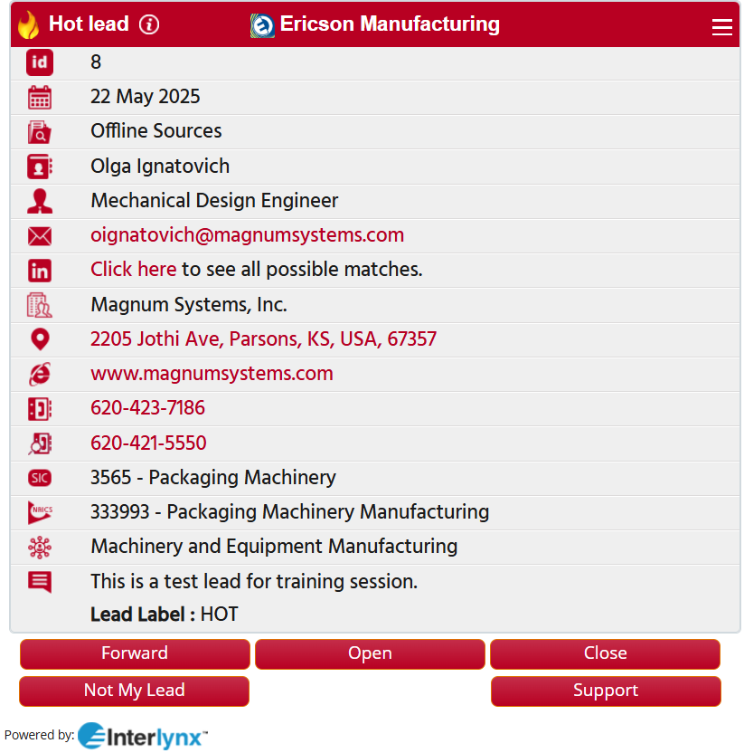
Why Users Love Interlynx Leads
Beautifully Crafted Leads
  Touch to Email
  Touch for LinkedIn
  Touch for Mapping
  Touch for Website
  Touch to Dial
  Backup Number
  Parent Company
  SIC Code
  Touch to Update
@2025 Interlynx Systems, LLC. All right reserved. No part of this presentation may be reproduced, distributed, or transmitted in any form or by any means, including photocopying, recording, or other electronic or mechanical methods, without the prior written permission of Interlynx Systems, LLC

Slide 5
Ericson Manufacturing Lead & Quote Policies
  Routing Policy:
  Lead will be assigned from HubSpot to Representative from Sales object with the Lead Type as “Interlynx - Sent”.
  Quote will be assigned from HubSpot to Representative from Deals object with Interlynx Send to Rep Agent as “Yes” .
@2025 Interlynx Systems, LLC. All right reserved. No part of this presentation may be reproduced, distributed, or transmitted in any form or by any means, including photocopying, recording, or other electronic or mechanical methods, without the prior written permission of Interlynx Systems, LLC

Slide 6
Ericson Manufacturing Lead & Quote Policies
  Lead Reminder Policy:
  Based upon Lead Label, following are the reminder policy for Representatives:
  Hot – 24 hours
  Warm – 2 days
  Cold – 5 days
  Quote Reminder Policy:
  Representatives will get a reminder after 5 days for a total 4 reminders.
@2025 Interlynx Systems, LLC. All right reserved. No part of this presentation may be reproduced, distributed, or transmitted in any form or by any means, including photocopying, recording, or other electronic or mechanical methods, without the prior written permission of Interlynx Systems, LLC

Slide 7
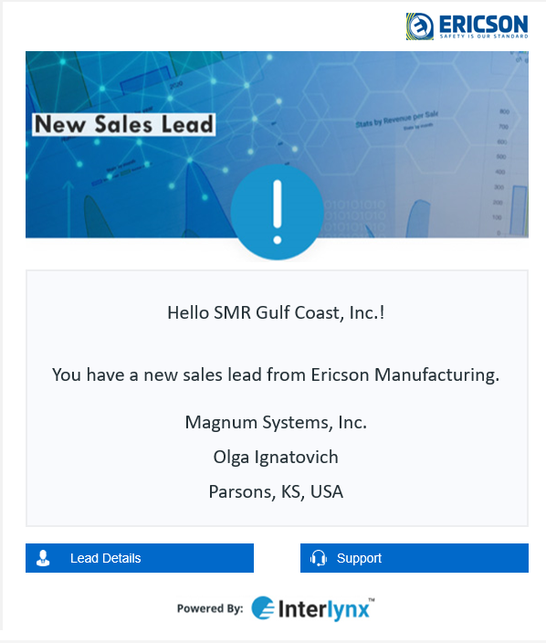
Leads - Email Based
Leads will arrive in your email and can be accessed via PC, tablet or mobile device

Slide 8
Lead Interface – Point Click Swipe
Simple email update process requires no logins
Simply update on status and submit

Slide 9
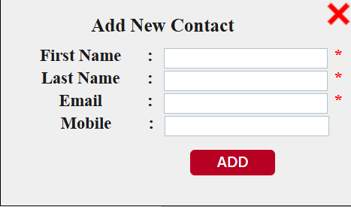
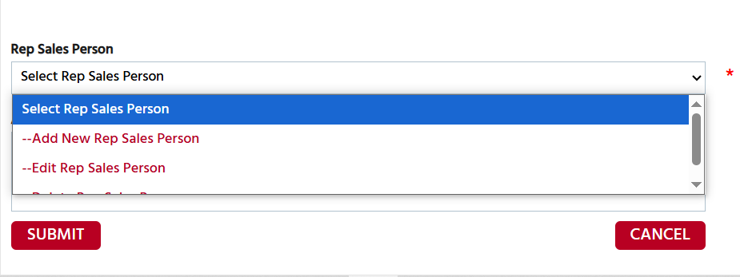
Forward The Lead or other rep sales person or add from the menu
  IST can forward the lead to Distributor
@2025 Interlynx Systems, LLC. All right reserved. No part of this presentation may be reproduced, distributed, or transmitted in any form or by any means, including photocopying, recording, or other electronic or mechanical methods, without the prior written permission of Interlynx Systems, LLC

Slide 10
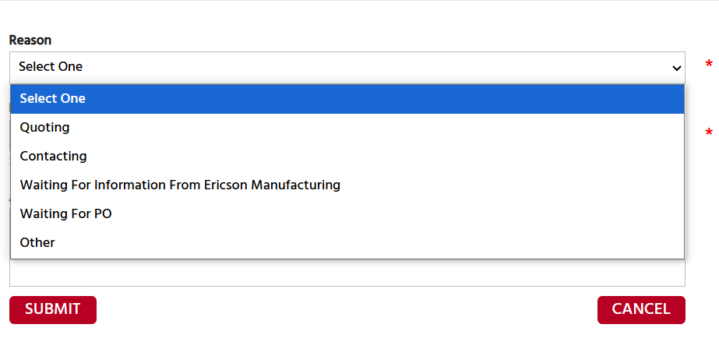
Select “Open” if You Need More Time
  A reminder will be sent on the day you have indicated

Slide 11
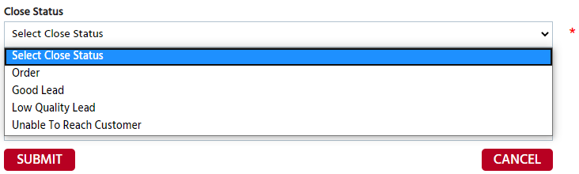
Closing The Lead
Report back on the lead status - select from the drop down

Slide 12
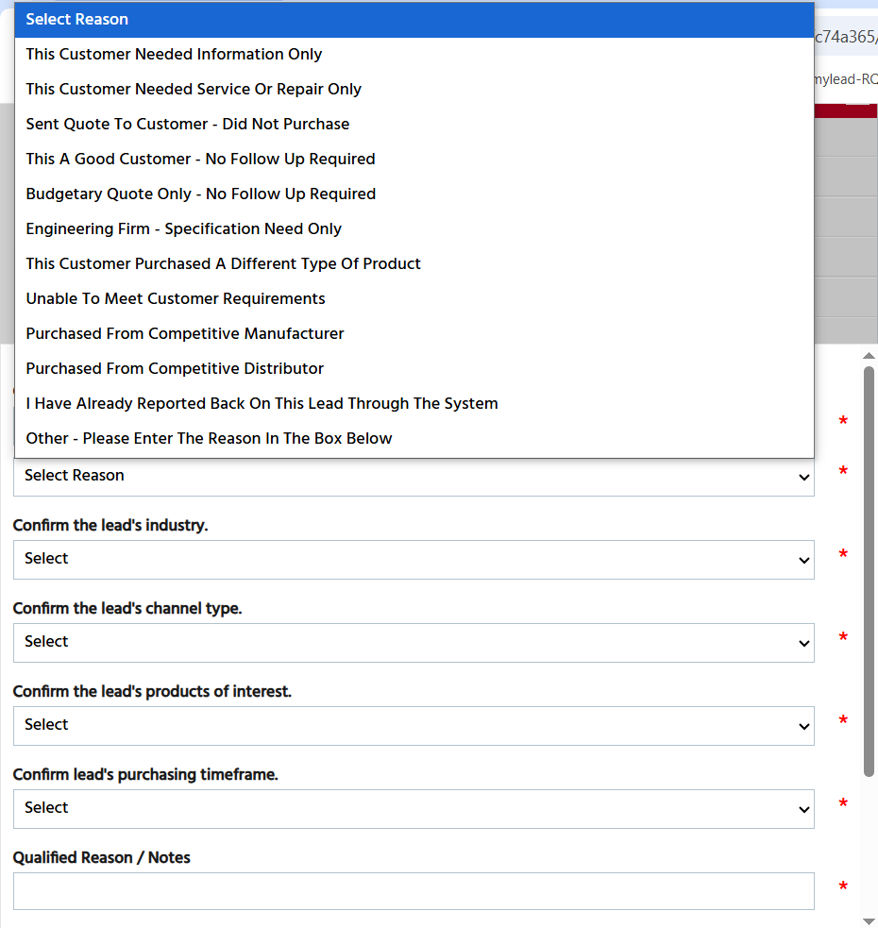
GOOD LEAD
  The lead had a good potential to generate business
  The lead opens a door for potential future new business
  Represents a key customer or market
  This will close the lead and no reminder will be sent.

Slide 13
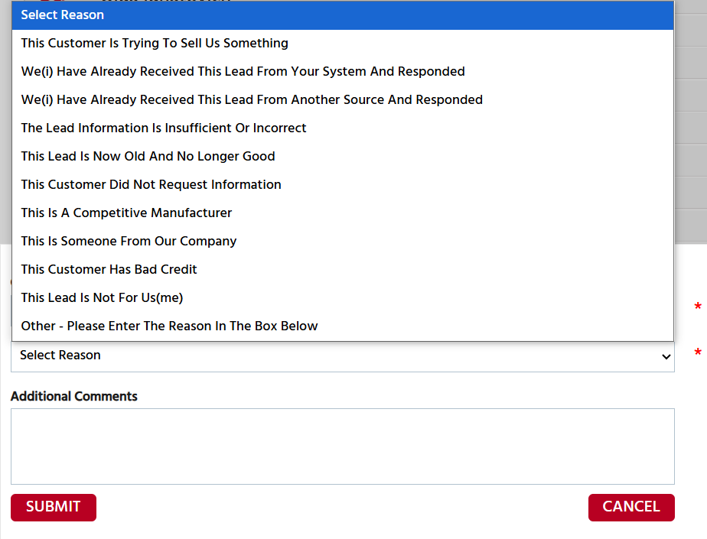
LOW QUALITY LEAD
  The lead had no potential
  Select a reason from the dropdown menu
  This will close the lead and no reminder will be sent.

Slide 14
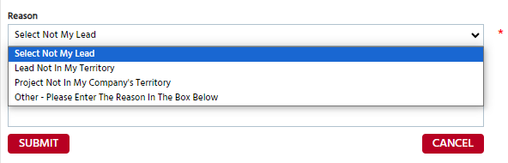
Select “Not My Lead” if It’s Not for You
NOT MY LEAD
  The lead does not belong to your territory
  This will close the lead and no reminder will be sent.
  Lead will be re-routed accordingly

Slide 15
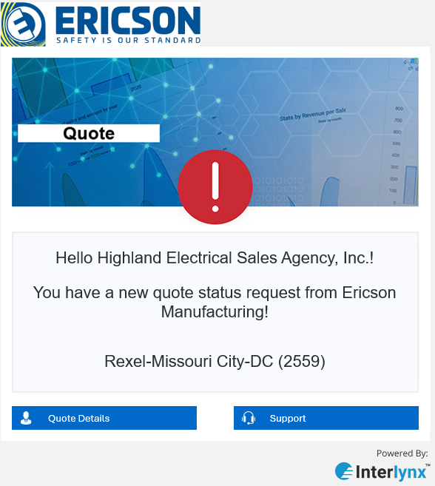
New Quotes - Email Based
Quotes will arrive in your email and can be accessed via mobile, tablet or desktop device

Slide 16
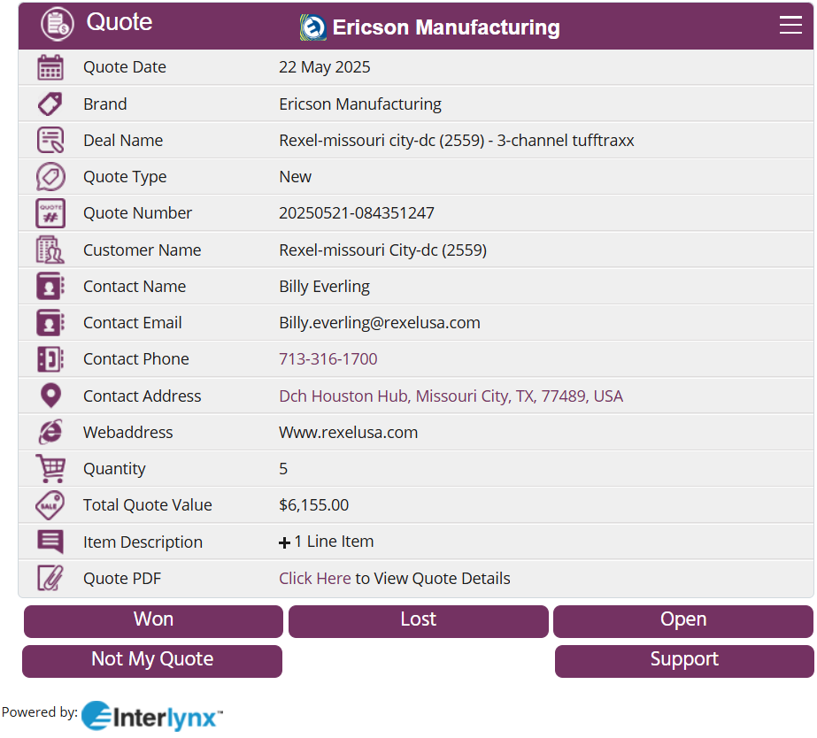
Quote Interface – Point Click Swipe
Simple email update process requires no logins
Simply update on status and submit

Slide 17
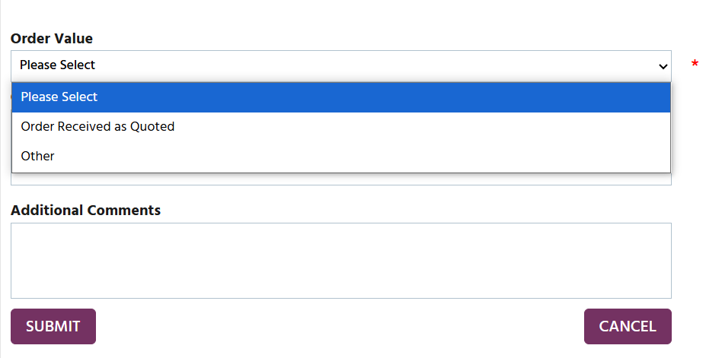
Select “WON” if There is an Opportunity

Slide 18
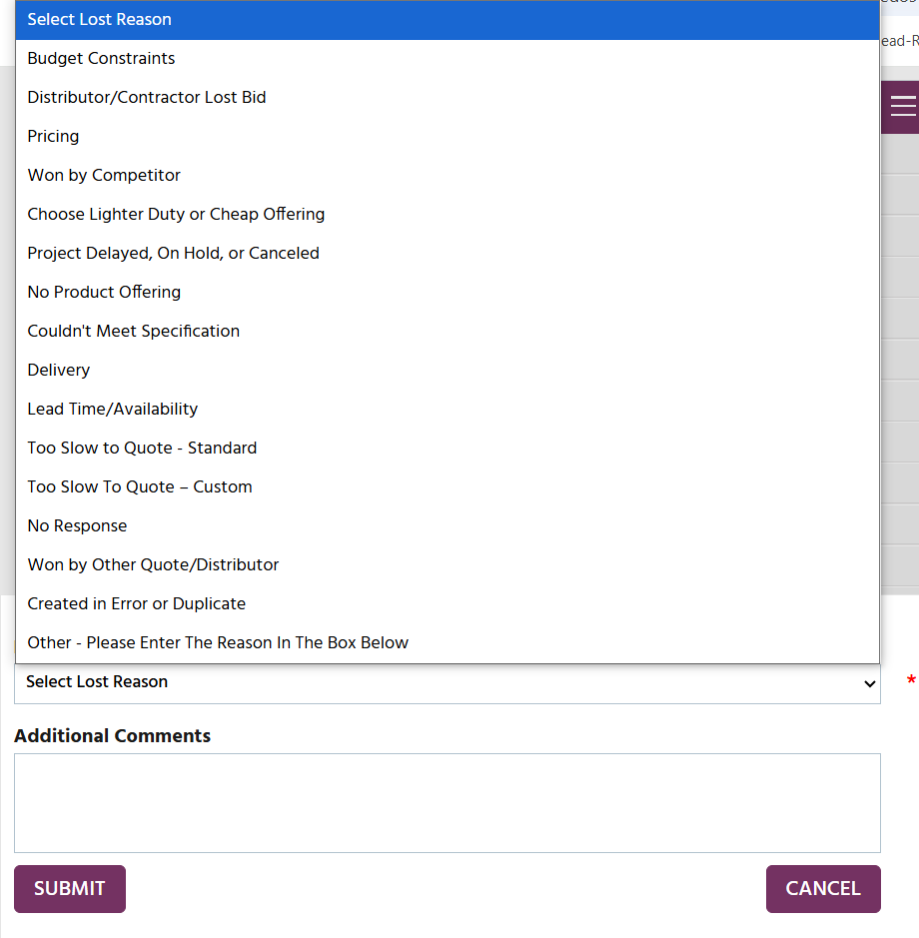
Select “LOST” if There is no Opportunity

Slide 19
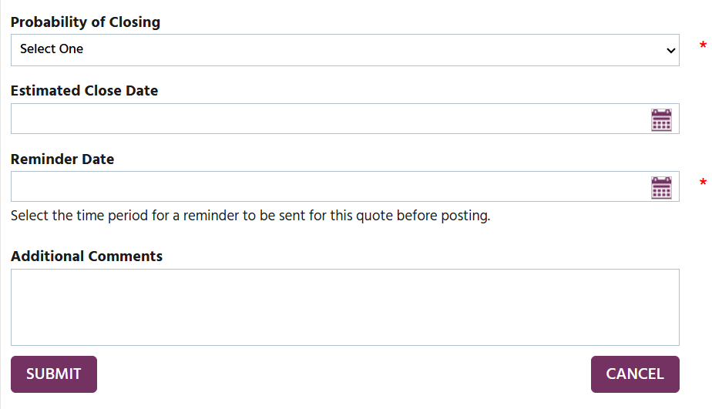
Select “Open” if You Need More Time
  A reminder will be sent on the day you have indicated

Slide 20
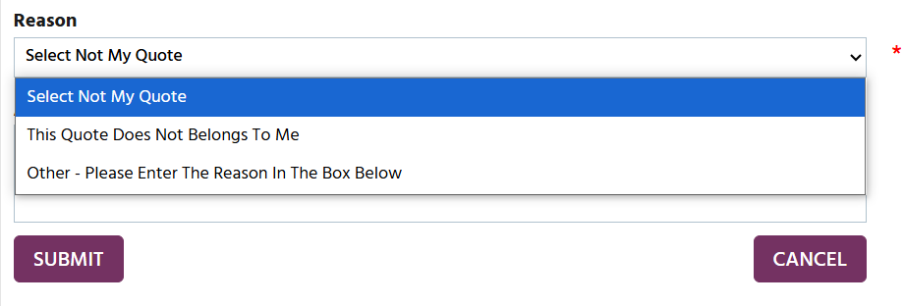
Select “Not My Quote” if the Quote is Not for You

Slide 21
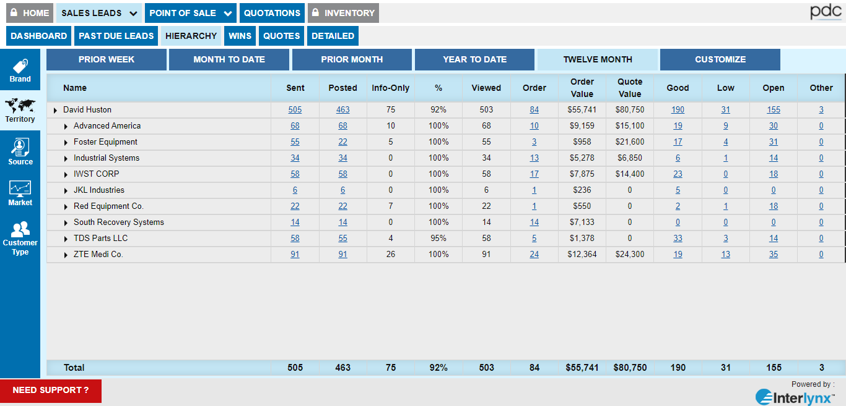
Sales Team Report Sample

